Slide 1
Final Project
CS 321-02 Spring 2019
Sean Mitchell, Megan Haskins, and Ansley Solomon

Slide 2
Introduction
Members, Responsibilities, and Workflow
Project Overview
Project Details
Use Cases
UML Diagram
Design Patterns
Gameplay demo
Conclusion

Slide 3
Project overview
Team Members and Roles
Sean Mitchell - Backend
Megan Haskins - Graphics
Ansley Solomon – XML/Database
Workflow
Weekly meetings in person to discuss progress
Communication via GroupMe application
Code stored and shared on Github
Project Statistics
N .java files
N images
N commits to Github

Slide 4
The Project – UAH Themed Monopoly
Set player names, timer for game
Create board
Player turns – roll dice, move token, end turn
Buy, sell, trade properties
Draw chance, community chest cards
Go to jail

Slide 5
The Project – Ansley Solomon
Gathered information for properties
Wrote all the Chance and Community Chance cards
Wrote the XML files
Wrote the XML parser
Added Javadoc comments
Classes I Wrote: Card, Decks, Property, Crosswalk, Utilities, PropertyList

Slide 6
The Project – Sean Mitchell
Wrote backend code for player and tile classes
Provided an interface between GUI and XML
Javadoc and inline documentation
Classes I wrote
Tile_Adapter, Player, Board, Dice_Roller, tile subclasses

Slide 7
The Project – Megan Haskins

Slide 8
UML Diagram

Slide 9
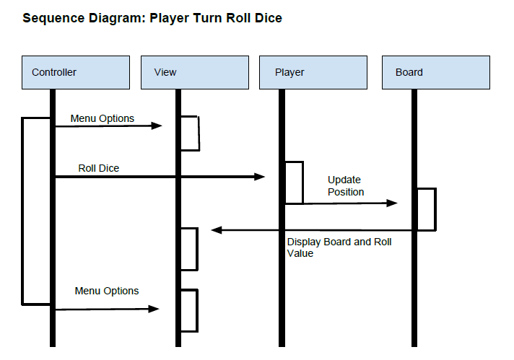

Slide 10
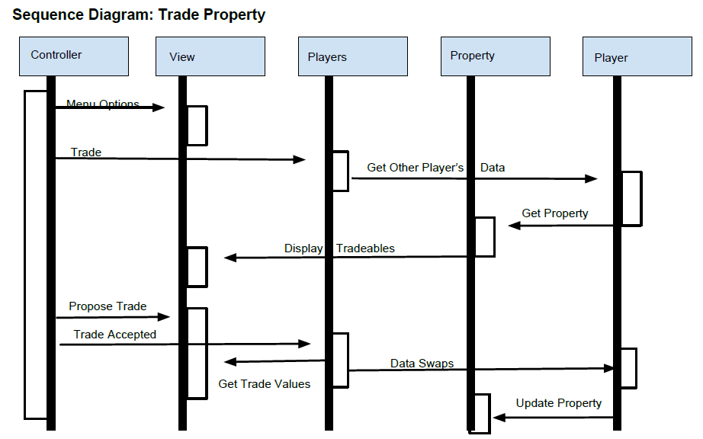

Slide 11
Design patterns
Passive MVC
Adapter

Slide 12
Demo
Real gameplay!

Slide 13
Conclusion
Final summary
UAH themed monopoly
Tiles and cards generated from XML on startup
Dynamic events for when a player lands on a tile or draws a card
Graphical interface for players to interact with
Questions?
Our GitHub
https://github.com/SeanMitchell1994/CS321_SP2019
Pull the .zip file under the v1.0 release if you want to play the game

